Slide 1


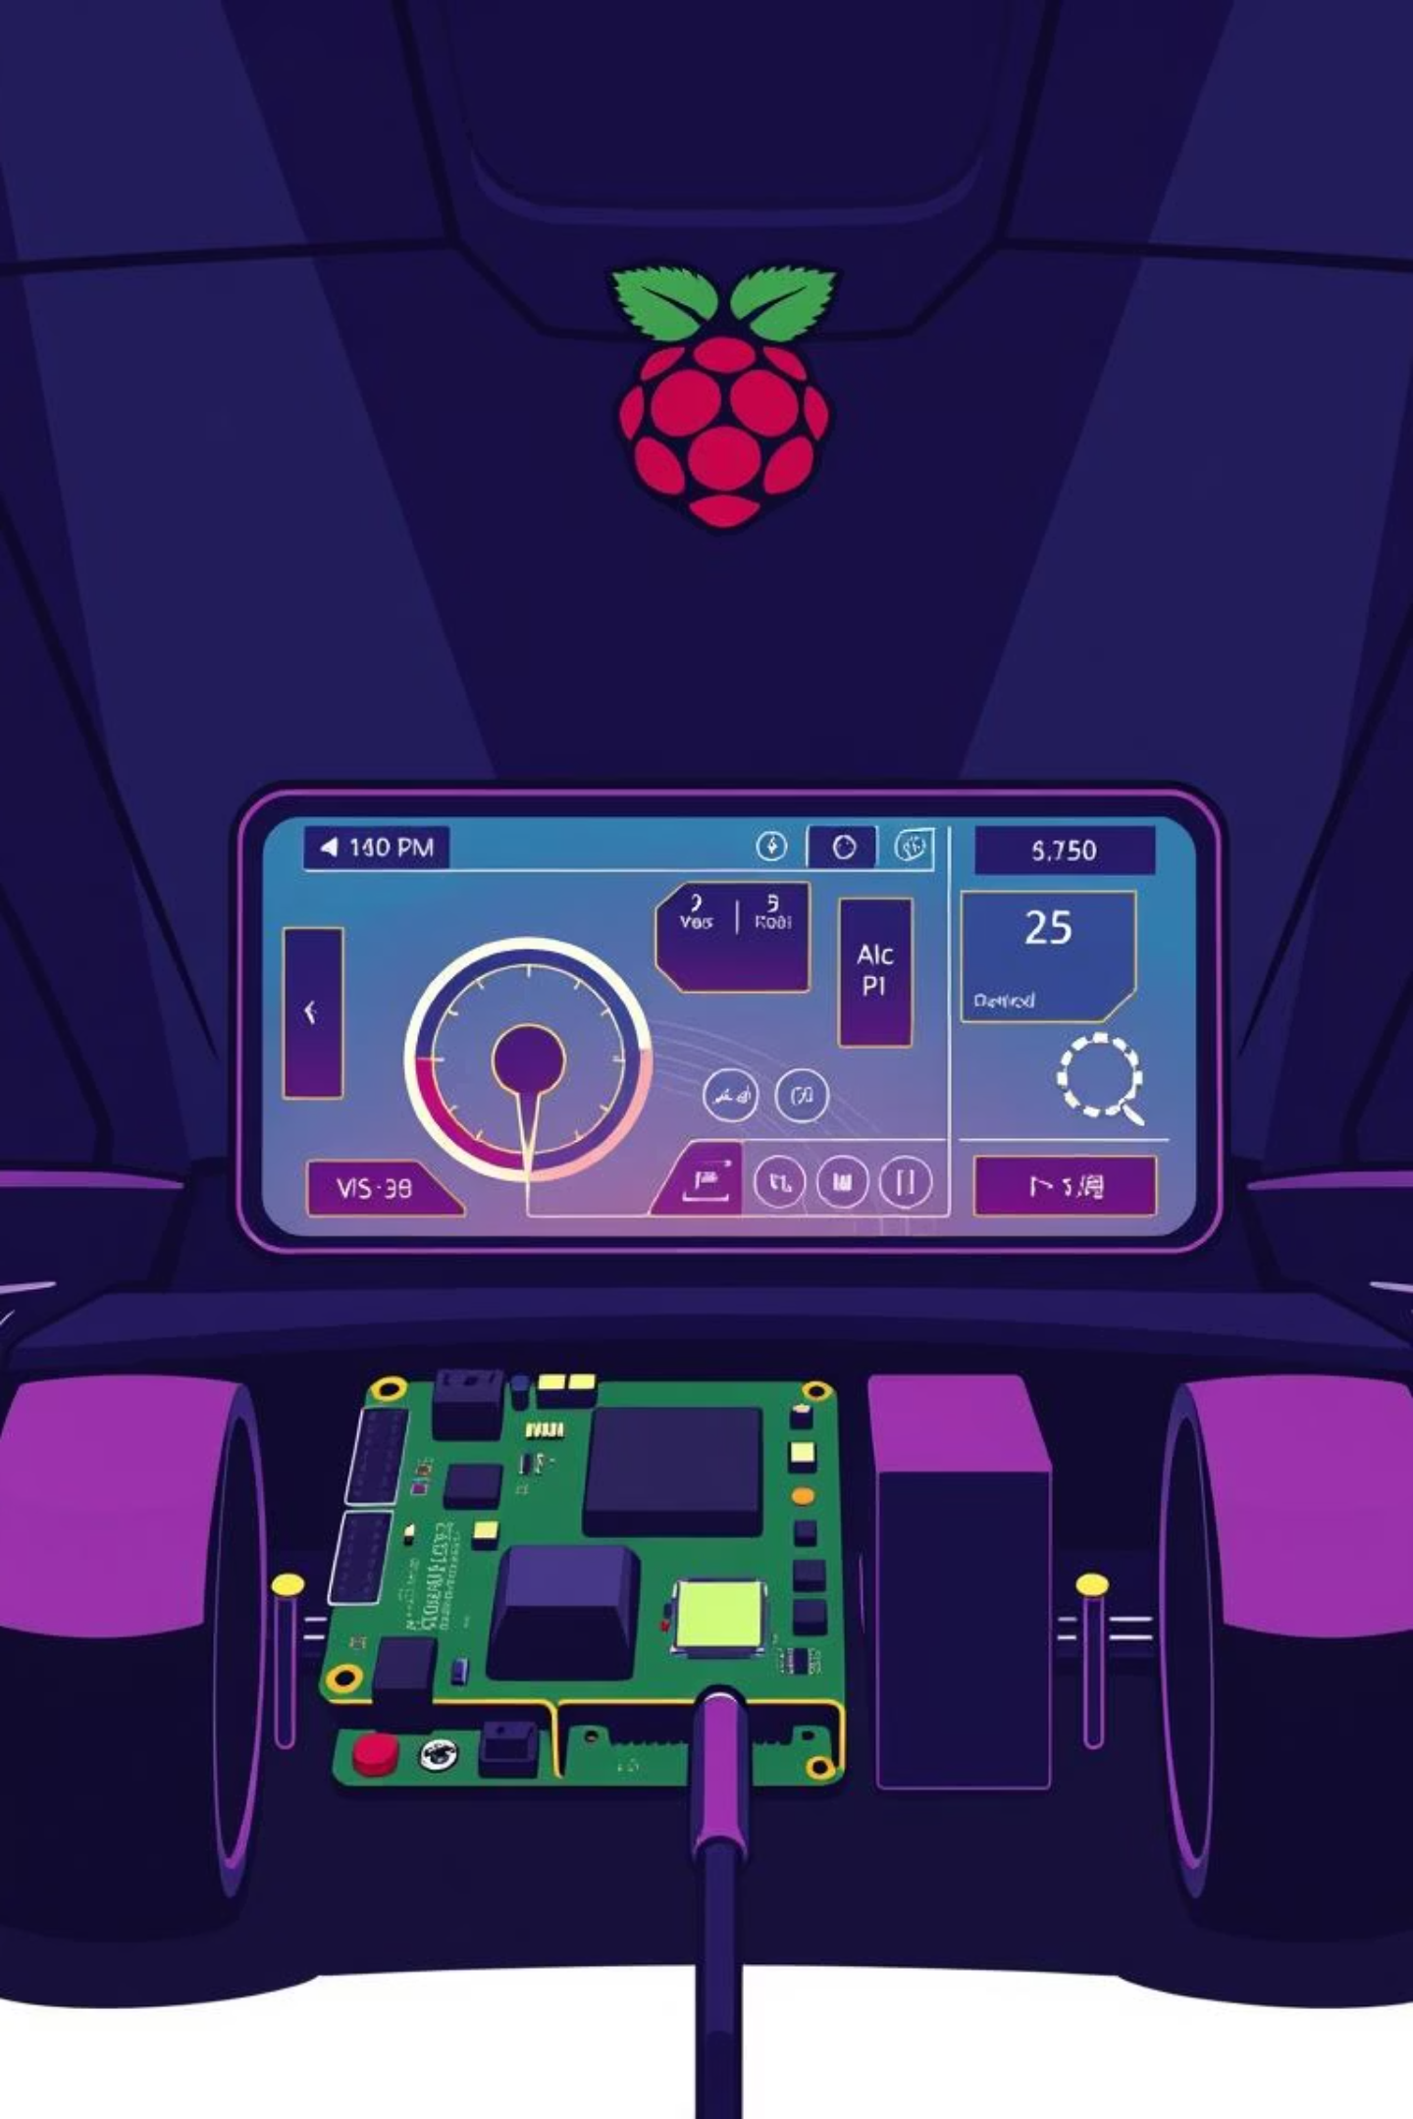
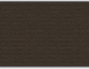

DES: Instrument Cluster
Team 03
Kijin Baek
Saicharan Sathyam

Slide 2

Presentation Agenda
Overview of the Instrument Cluster system and its key features
Detailed hardware requirements and system architecture
Sensor node operations and data communication flow
Remote control and cross compilation techniques
Qt5/QML GUI implementation and performance optimizations
Summary of data communication and system integration

Slide 3
Key Features
Real-time Speed Display
Speed monitoring in cm/s with Kalman Filtering for smooth readings
Battery Display
Shows battery percentage with visual indicator
Gear Display
Shows current gear (P/R/N/D)
Turn Signal Indicators
Left/right turn signals with blinking animations
Cross Compilation
Runs on development machine and cross-compiles for Raspberry Pi 4

Slide 4
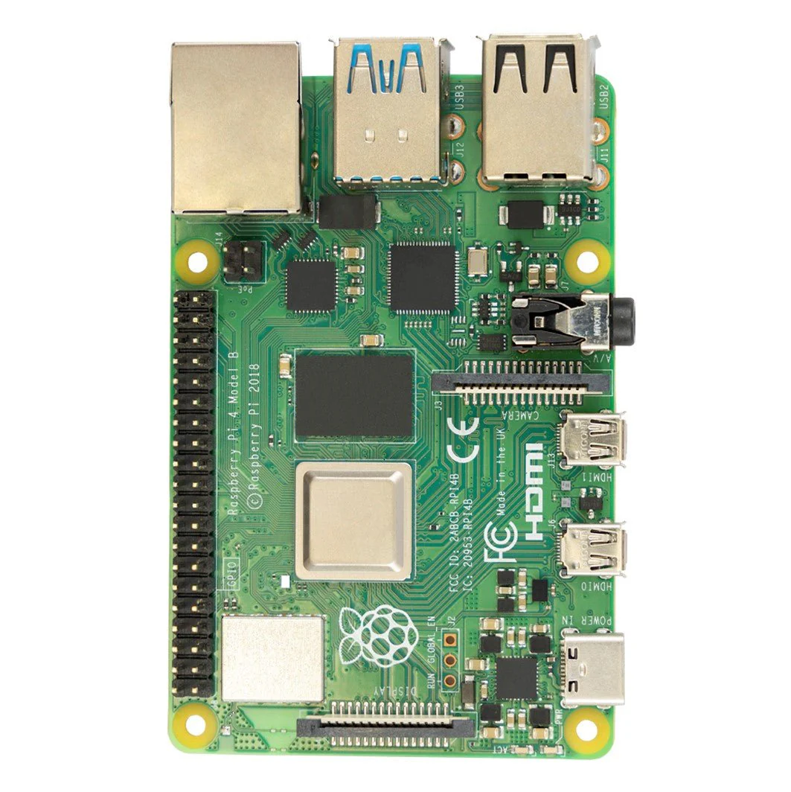
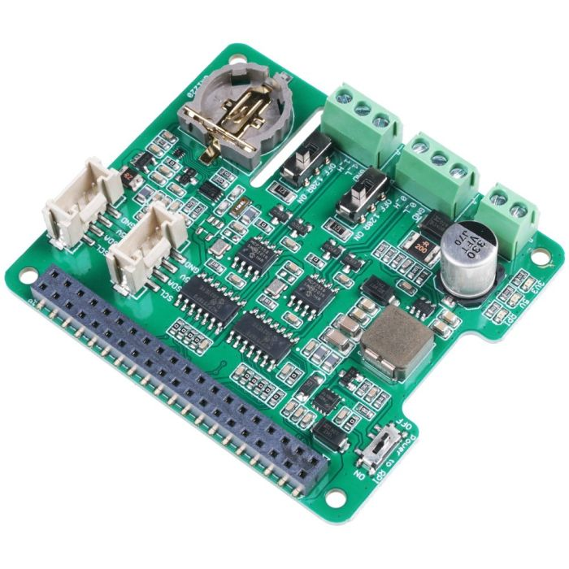
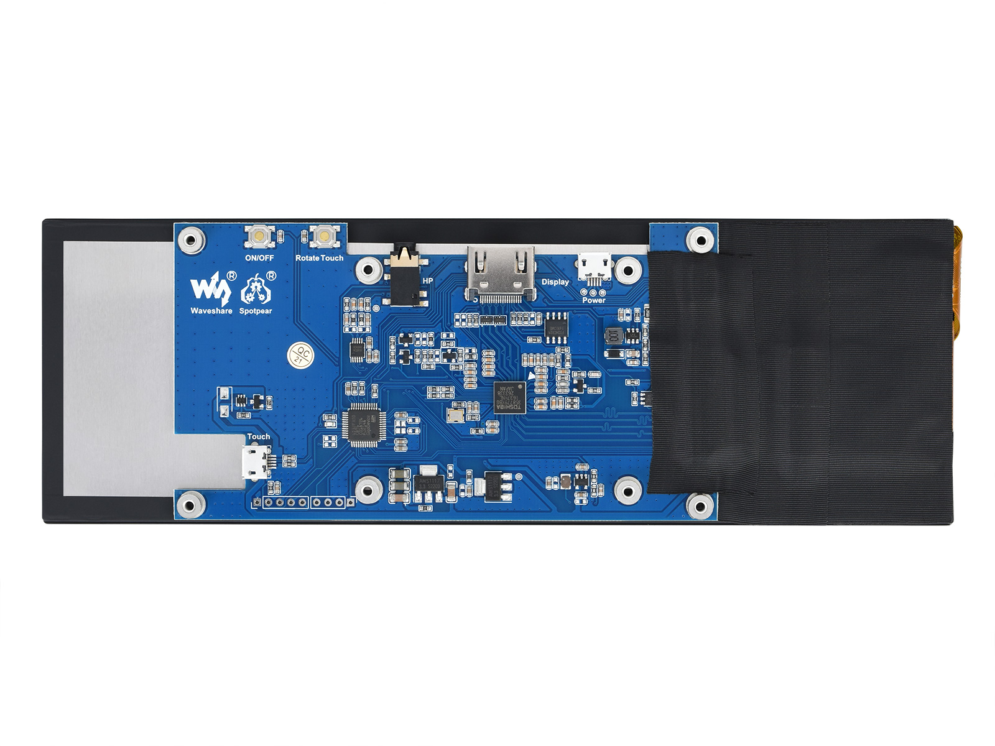
Hardware Requirements
Raspberrry Pi
CAN_BUS HAT
7.9inch Display

Slide 5
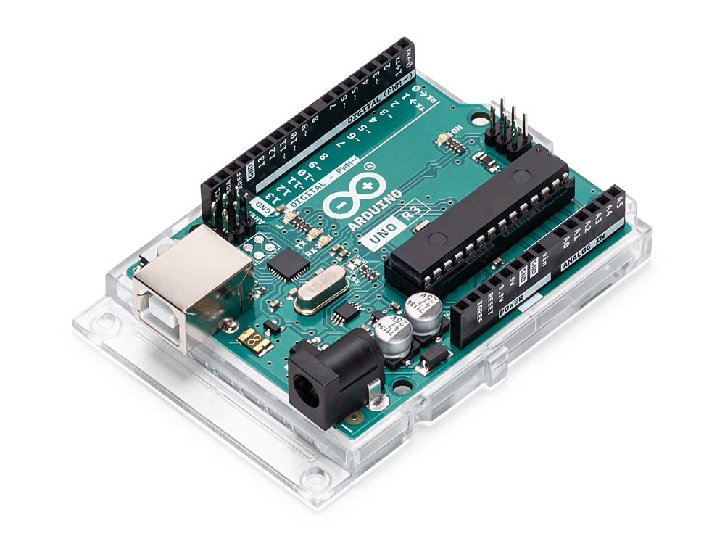
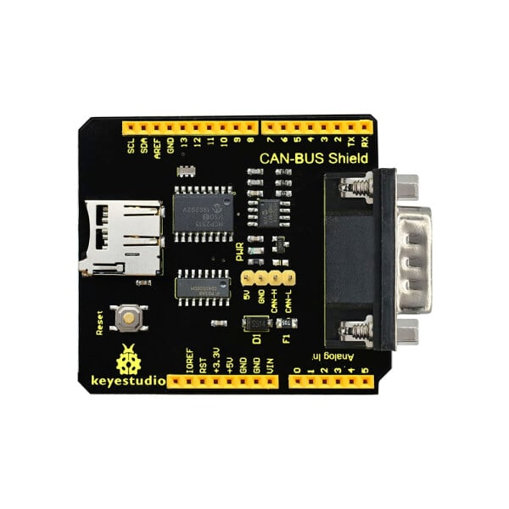
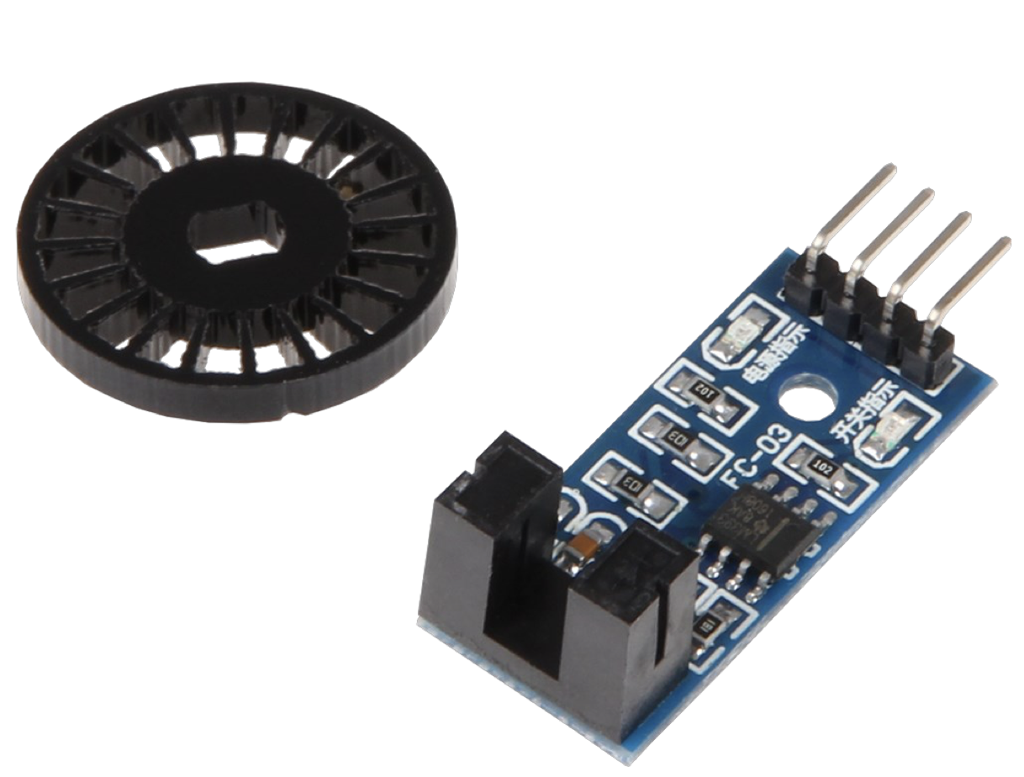
Hardware Requirements
Arduino Uno
CAN_BUS Sheild
Speed Sensor (LM 393)

Slide 6
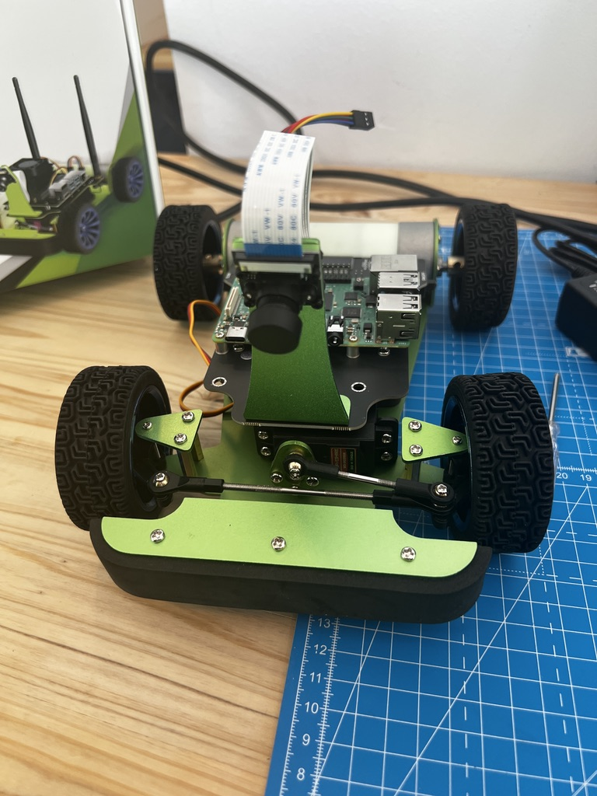
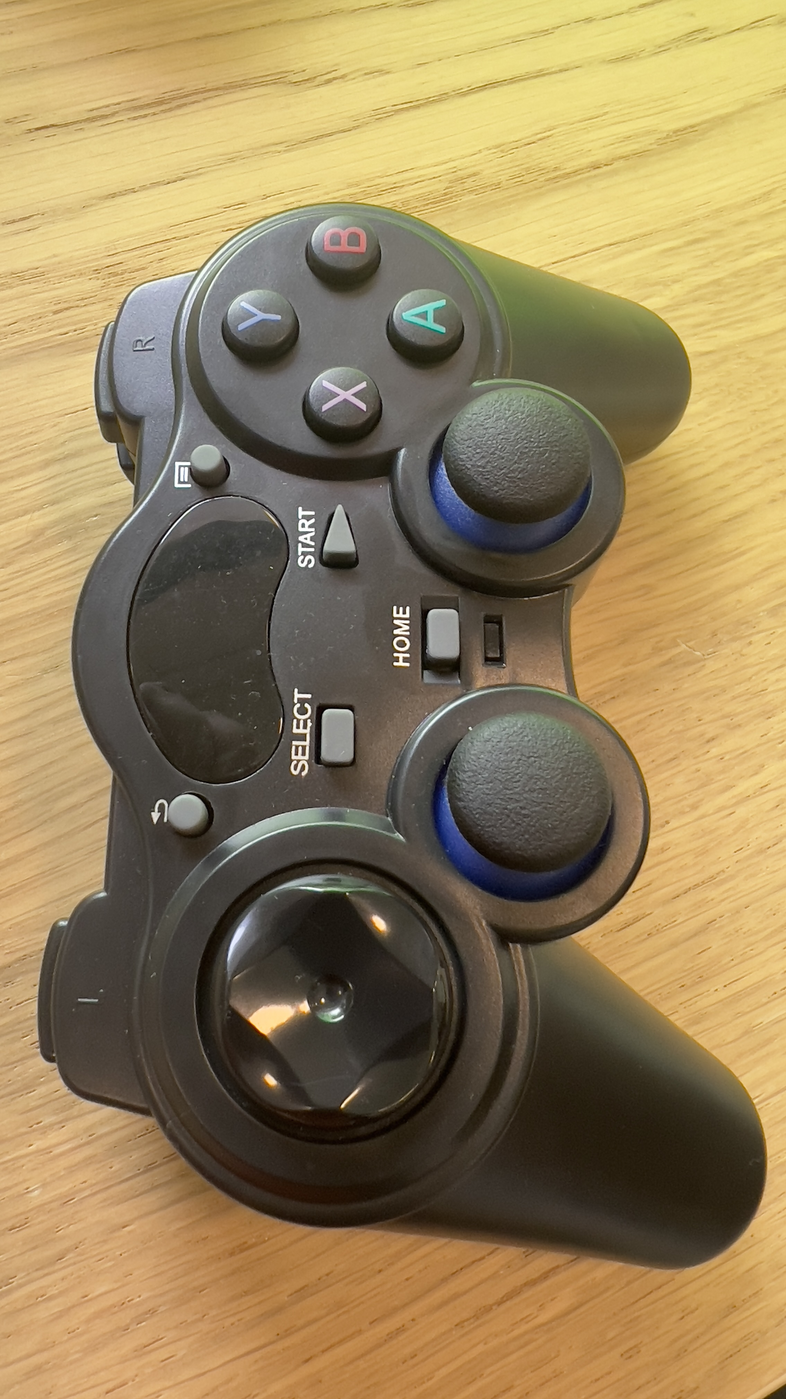
Hardware Requirements
PiRacer Standard Kit
Joystick

Slide 7
System Overview
Arduino (sensors)
CAN Bus
D-Bus Service
QT5/QML GUI
Remote Control

Slide 8
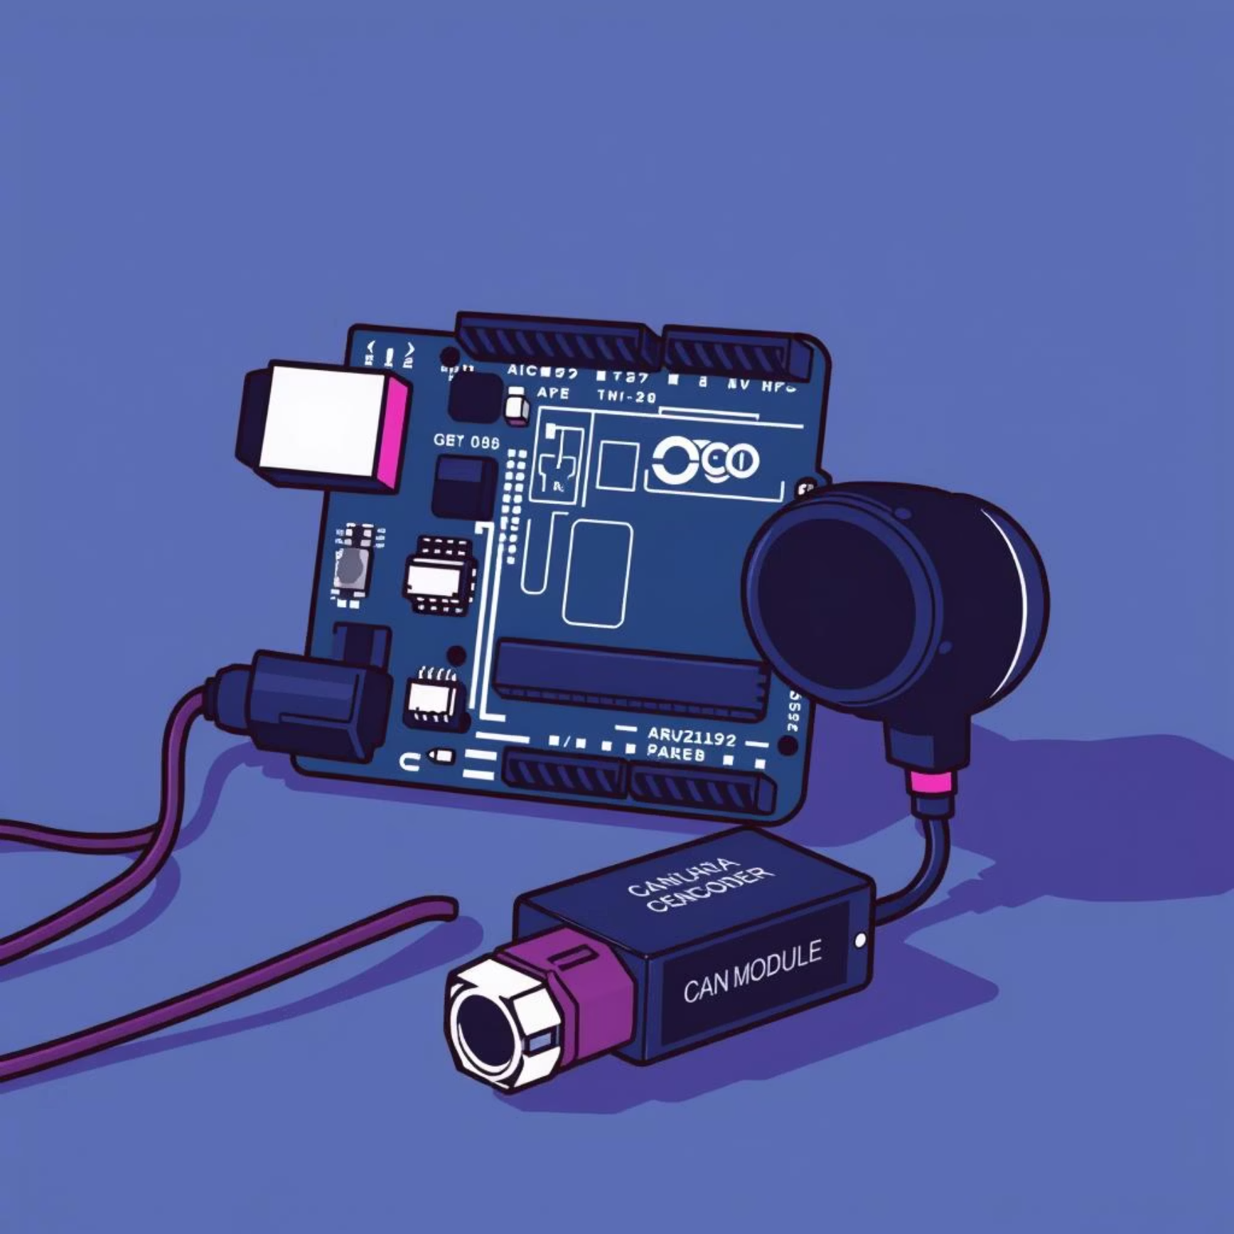
Arduino Sensor Node
Real-time Processing
Setup CAN Controller
Configure MCP2515 for communication
Configure Speed Sensor
Set up encoder interrupt handling
Calculate Speed
Process encoder pulses
Send Data
Transmit speed via CAN (ID: 0x100) every 50ms

Slide 9

D-Bus Service
Battery Thread
Poll INA219 sensor every second
Signal Emissions
Emits updates to GUI
CAN Thread
Receive speed, apply Kalman Filter
D-BUS Methods
Handle Gear and Turn Signals

Slide 10
2-State Kalman Filter Execution
State Prediction
(Velocity, Acceleration)
Sensor Measurement
(Arduino CAN Message)
Innovation Calculation (Prediction Error)
Kalman Gain Computation
(K = 0-1)
Covariance Update
(Confidence adjustment)
State Update
(Corrected speed based on K and Innovation)
Output Generation
(Filtered output to DBus)

Slide 11
Remote Controller
Initialize Gamepad and PiRacer
Connect to D-Bus service
Read Gamepad Input
Apply Gear Based Logic
Read D-Pad Input
Read Turn Signal Buttons
Set Steering and Throttle
Send Gear Commands
Send Turn Signal Commands

Slide 12
Cross Compilation
Compilation Strategy
Stage 1: Use host (x86_64) Qt tools to generate C++ code from your Q_OBJECT classes
Stage 2: Cross-compile the generated code using ARM64 toolchain
Stage 3: Link with target libraries from the sysroot
Host
x86_64 Ubuntu Development Machine
Target
ARM64 Raspberry Pi4 (aarch64)

Slide 13
Qt5/QML GUI Implementation
Architecture and Data Flow :
[CAN Bus] → [Python Aggregator] → [D-Bus Service]
[C++ Bridge: PiRacerBridge]
[QML GUI: main.qml]
Key Design Pattern :
D-Bus signals → C++ slots → Qt properties → QML bindings
Initial value fetch via D-Bus methods prevents empty UI on startup
Change detection prevents redundant UI update

Slide 14
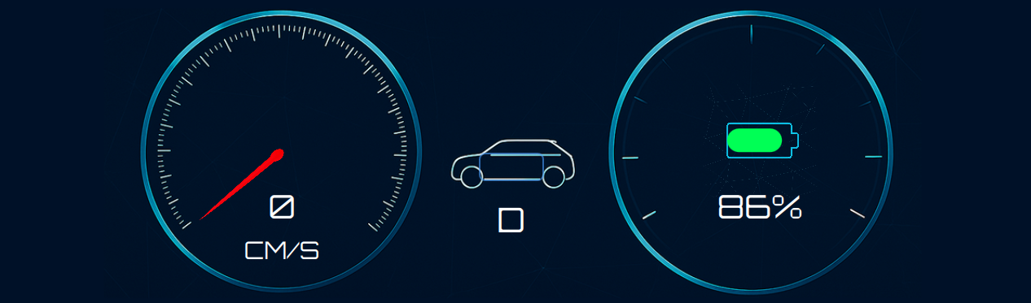
Qt5/QML GUI Implementation
Performance Optimizations :
GPU-friendly animations with easing curves
Property binding efficiency - updates only on actual value changes
60 FPS rendering with smooth transitions (180-400ms timing)

Slide 15
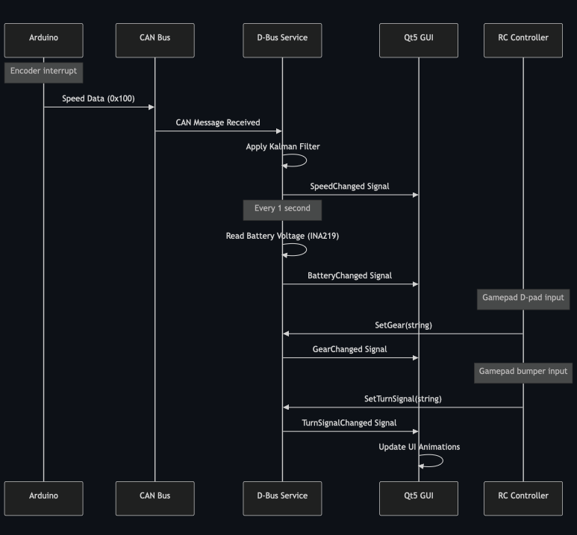
Data communication flow

Slide 16
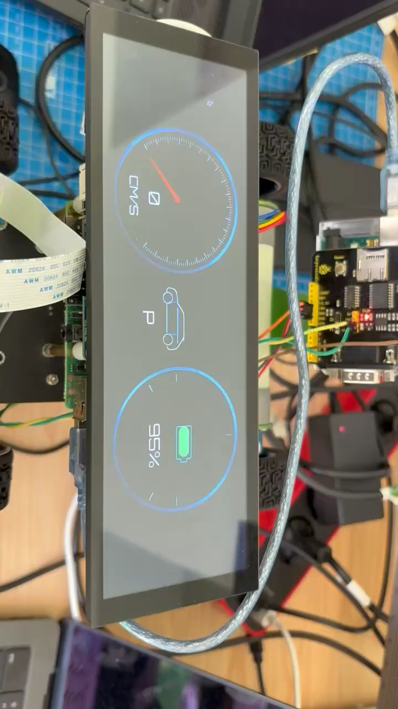
Result

Slide 17


